Slide 1
The JH Hash Function
The Pro Side of Things

Slide 2
Scope
Background
How JH works
Pros/Cons
Cryptanalysis
Comparison to Other Finalists
Conclusion

Slide 3
Background of JH
Created by Hongjun Wu alone
Submitted to the NIST hash competition October 2008
Digest sizes: 224, 256, 384, 512
Speed of 19.6 cycles/byte on 64-bit OS
Speed of 23.3 cycles/byte on 32-bit OS

Slide 4
How JH Works
Takes message blocks of 512-bits and generates hash values of 224, 256, 384, and 512 bits.
5 Steps
Padding the message
Extra bits are added to the message so that it has a length that is a multiple of 512.
Parsing the padded message
Each block is split into 128-bit blocks denoted M_{a}^{(i)}.

Slide 5
How JH Works Cont.
Setting the initial hash value
Value depends on digest size
H⁽⁰⁾ = F₈(H⁽⁻¹⁾, M⁽⁰⁾)
H⁽⁻¹⁾: the first 2 bits are digest size, remaining are set to 0.
M⁽⁰⁾ is set to 0.
Computing the final hash value
F₈ is applied to each 512-bit block iteratively until the final hash is generated.
Generating the message digest
Depending on digest size (n), the last n bits are taken from the computed final hash.
For more information see:
http://www.cs.rit.edu/~hpb/Lectures/20112/S_T/Src/32/JH_hash_function_presentation.pdf

Slide 6
Pros/Cons
Built from very simple components
Simple components allow for easy implementation in hard ware
Simple components make the algorithm quick in both hardware and software
Works as a drop in replacement of SHA2
The best attack on JH requires very large resources to implement and during the decision process were uable to be verified

Slide 7
Pros/Cons Cont.
"Keccak has the largest security margin, with 79% of its hash function still unbroken; JH has the smallest security margin, with 38% unbroken“ ¹
"there is no known way for an attacker to exploit the JH domain extension to find preimages, or second preimages more efficiently than a brute-force search“ ¹

Slide 8
Pros/Cons Cont.
256 Sboxes can be computed in parallel
Of the finalists, BLAKE and JH were only tweaked to increase the number of rounds. This does not affect any cryptanalysis prior to the tweak and is, therefore, the most innocuous type of tweak.
While a pseudo-collision attack exists on the JH compression function (because of its ability to be reversed) it was deemed to be minor
MAC is not the greatest in terms of efficiency
Push for dedicated MAC protocol in place of using hashing functions for MACs ²

Slide 9
Cryptanalysis
JH has optimal security for collision search attacks
Strong against differential attacks
Compression function uses 10752 4x4 bit sboxes
Trail involves more than 700 sboxes
Preimage attack is more expensive than brute force
Large security margin
Brute force is best attack

Slide 10
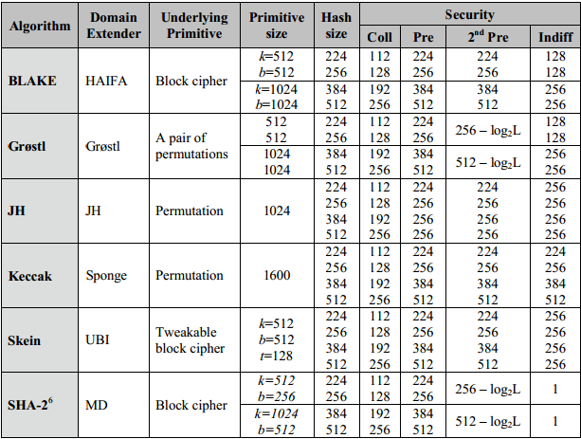
Comparison to Other Finalists

Slide 11
Conclusion
Simple to implement in software and hardware
Easy to analyse
Strong against different kinds of attacks
Impressive that it was developed by just one person
Close competitor to Keccak
Overall solid hash function

Slide 12
Q&A

